Slide 1
Cognitives Services Demos & hands-on

Slide 2
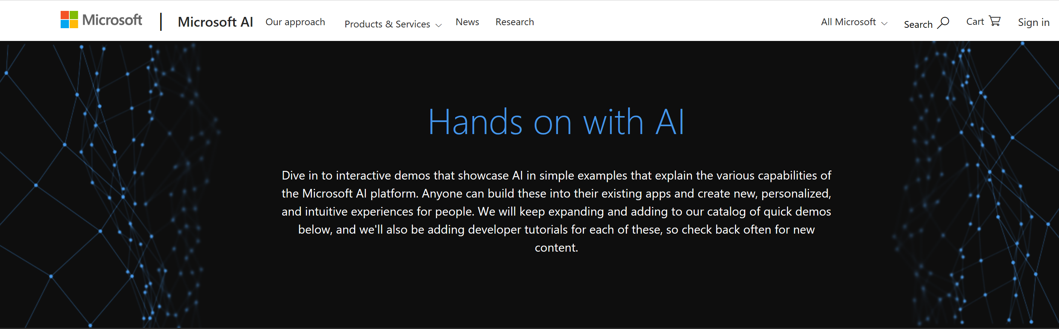
Demos & hands-on
Demos and hands-on dans le site Microsoft AI School
https://aidemos.microsoft.com/

Slide 3
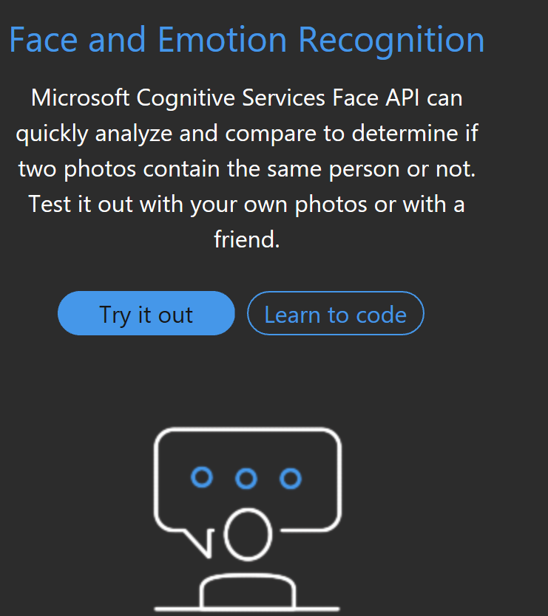
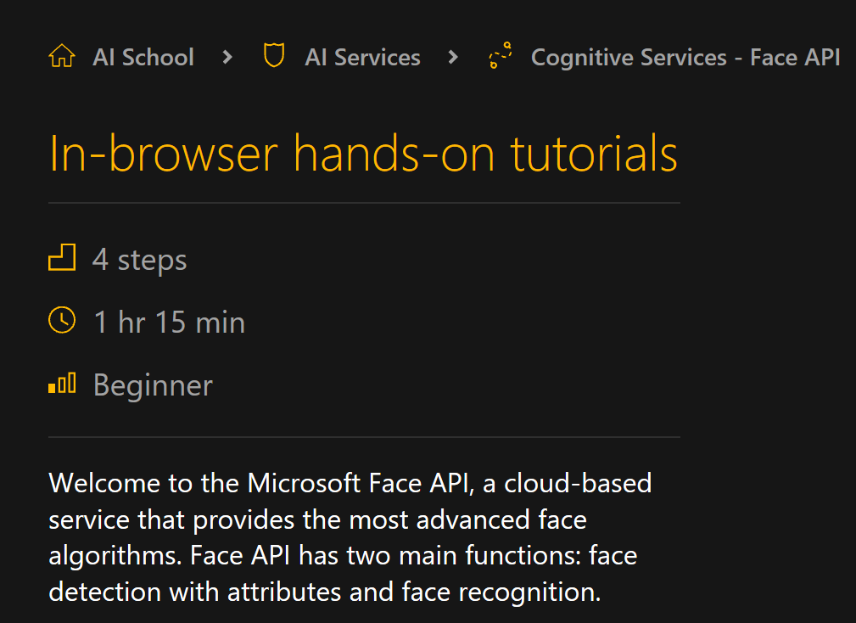
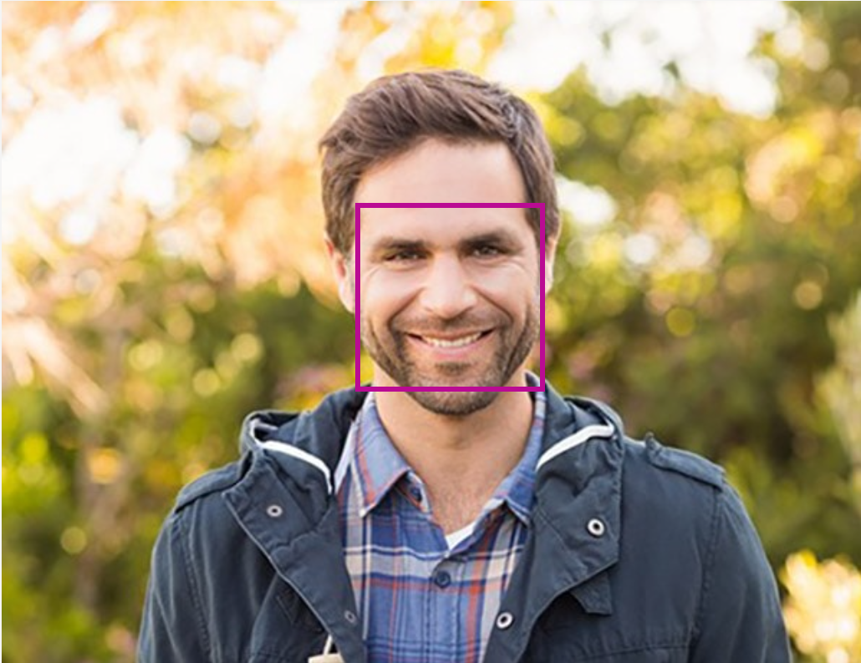
Demos & hands-on Face API
https://azure.microsoft.com/fr-fr/services/cognitive-services/face/
https://aidemos.microsoft.com/face-recognition
https://aischool.microsoft.com/en-us/services/learning-paths/cognitive-services-face-api/in-browser-tutorials-face-api

Slide 4
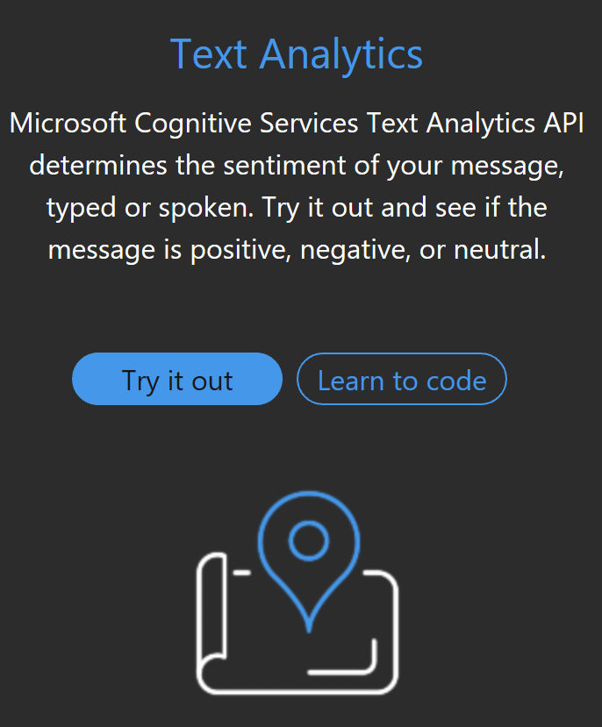
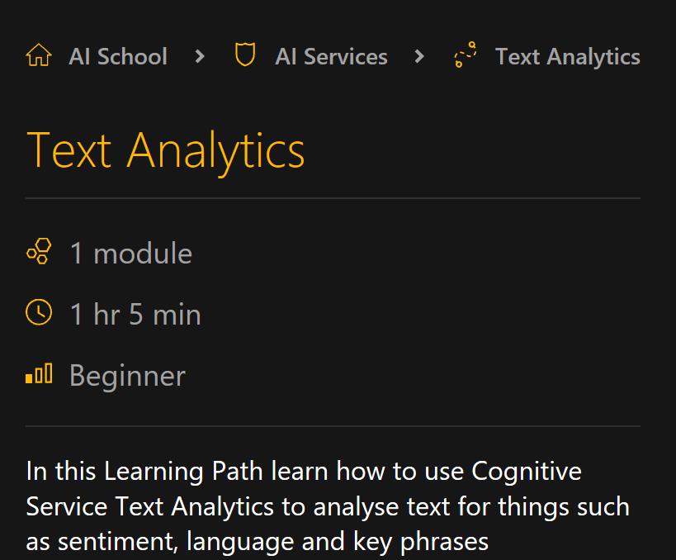
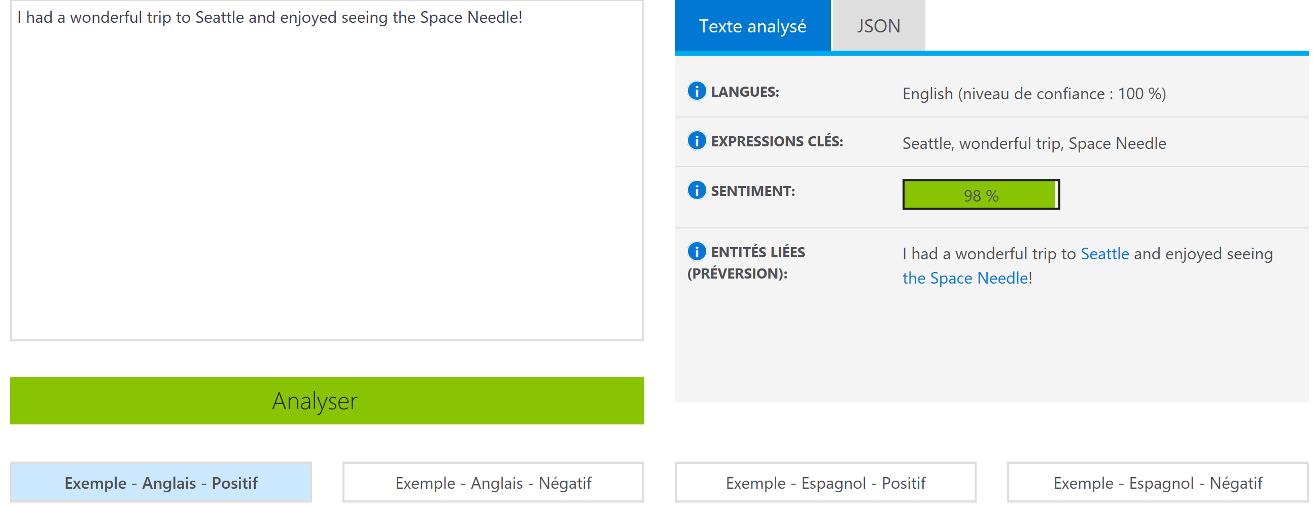
Demos & hands-on Text Analytics
https://azure.microsoft.com/fr-fr/services/cognitive-services/text-analytics/
https://aidemos.microsoft.com/text-analytics
https://aischool.microsoft.com/en-us/services/learning-paths/cognitive-services-text-analytics

Slide 5
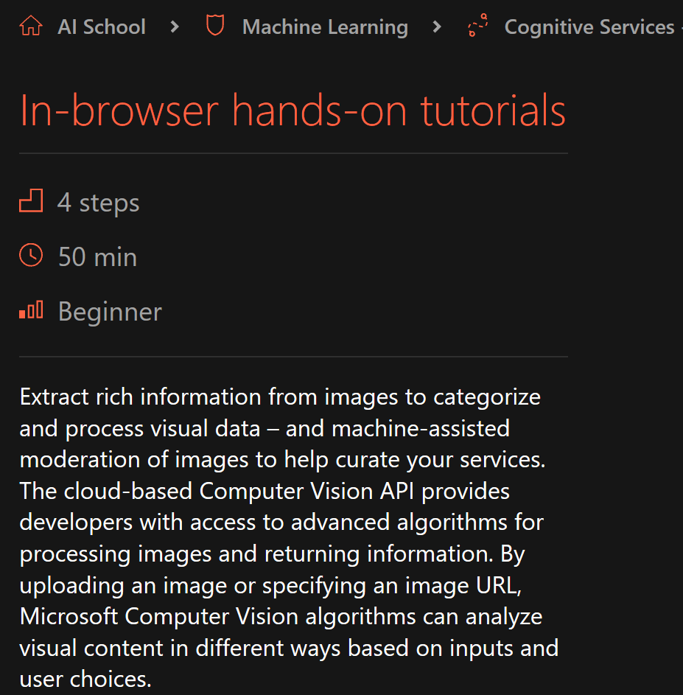
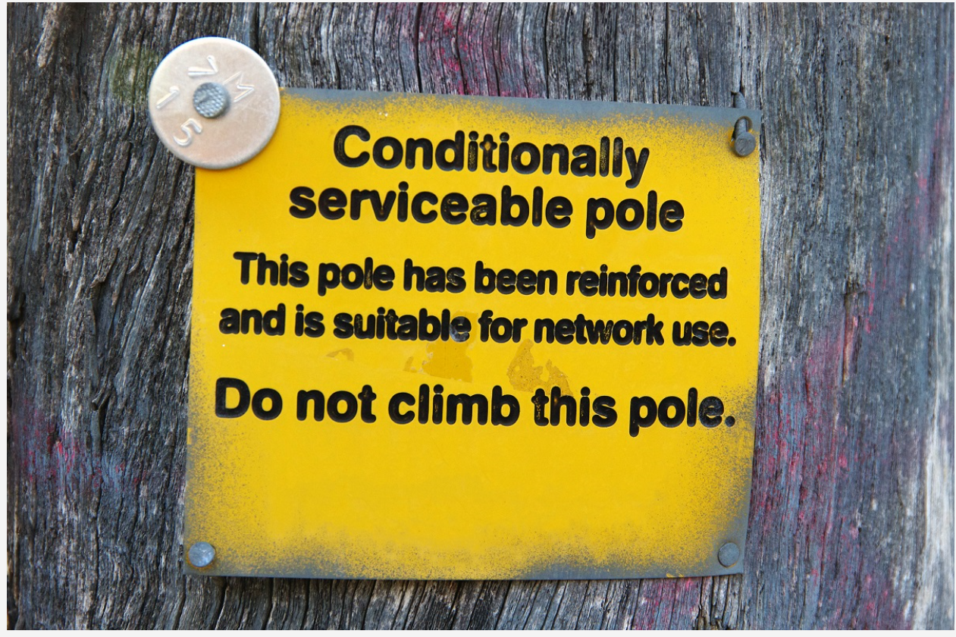
Demos & hands-on Computer Vision
https://azure.microsoft.com/fr-fr/services/cognitive-services/computer-vision
https://aischool.microsoft.com/en-us/machine-learning/learning-paths/cognitive-services-computer-vision-api/in-browser-tutorials-extract-from-images

Slide 6
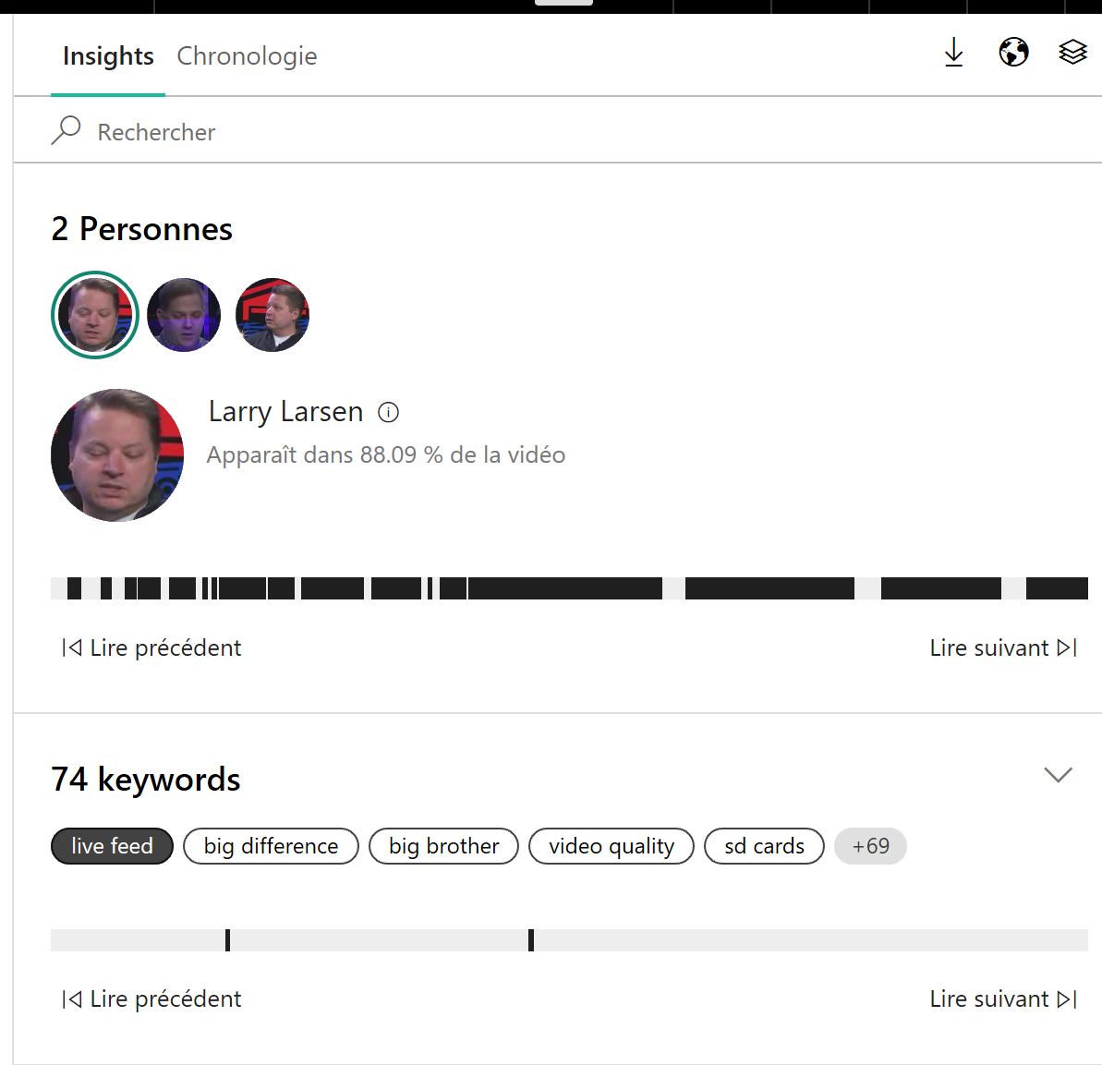
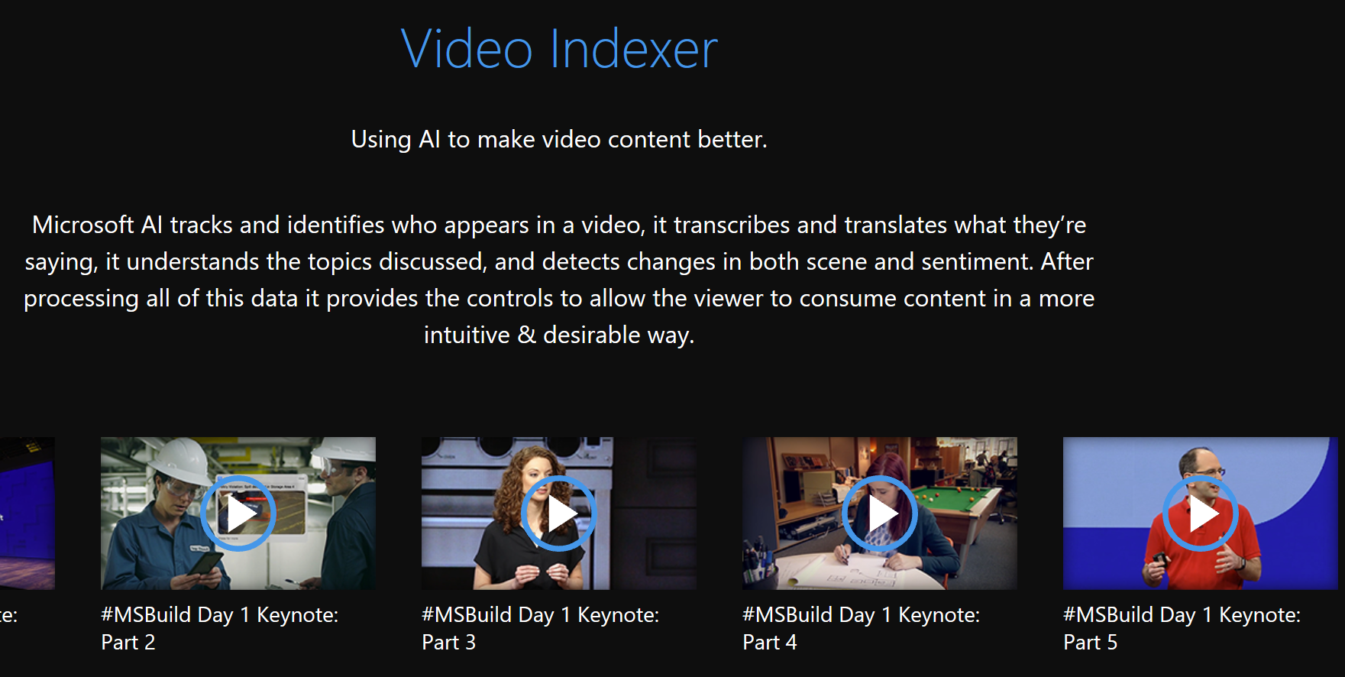
Demos & hands-on Video Indexer
https://aidemos.microsoft.com/video-indexer
https://www.videoindexer.ai

